Slide 1
NYC Taxi Trip Duration

Slide 2
Supervised by :
Dr. Lydia Wahid
Presented by :
Yousef Mostafa Elmahdy
Ahmed Waleed
Gaser Ashraf Fayez
Mohamed Salama

Slide 3
Agenda
Data Preprocessing
Data Visualization
Extracting Insights From Data
Models
Results
Future Works

Slide 4
Data Preprocessing

Slide 5
Handling Missing Values
Removing Rows with Missing Data
Handling Datetime
Handling Passenger Count
Handling Trip Duration

Slide 6
Data visualization

Slide 7
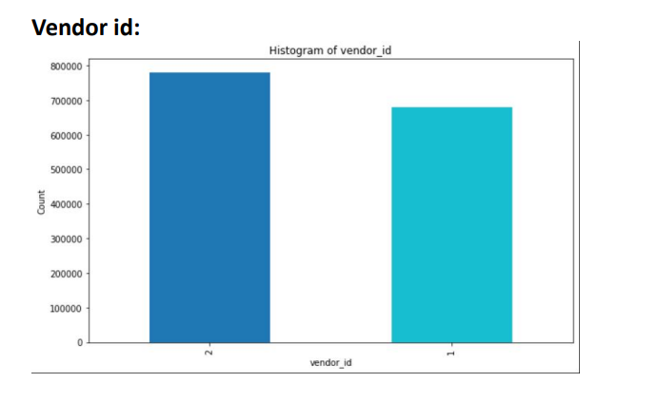

Slide 8
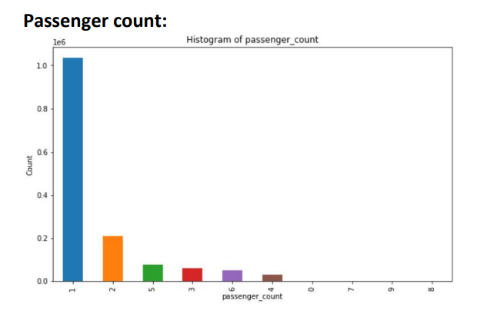

Slide 9
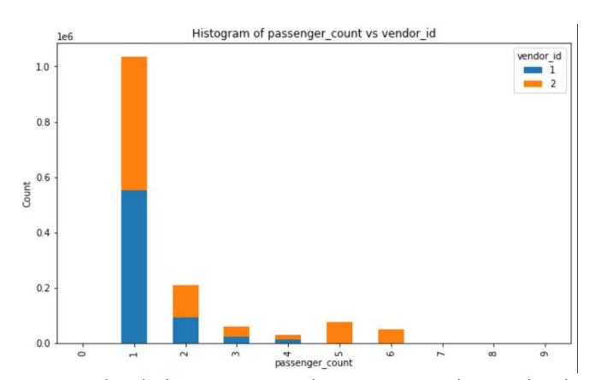

Slide 10
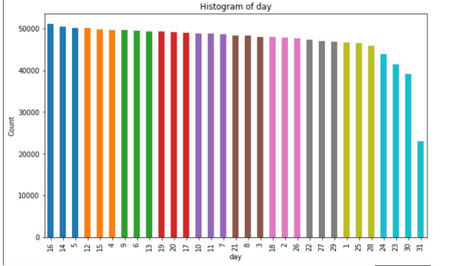

Slide 11
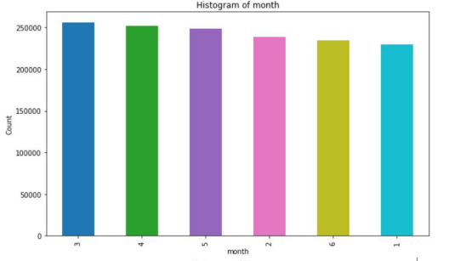

Slide 12
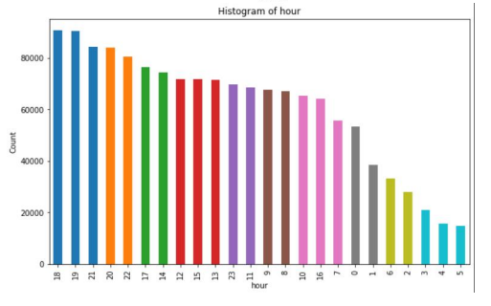

Slide 13
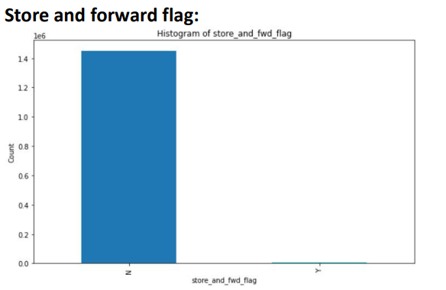

Slide 14
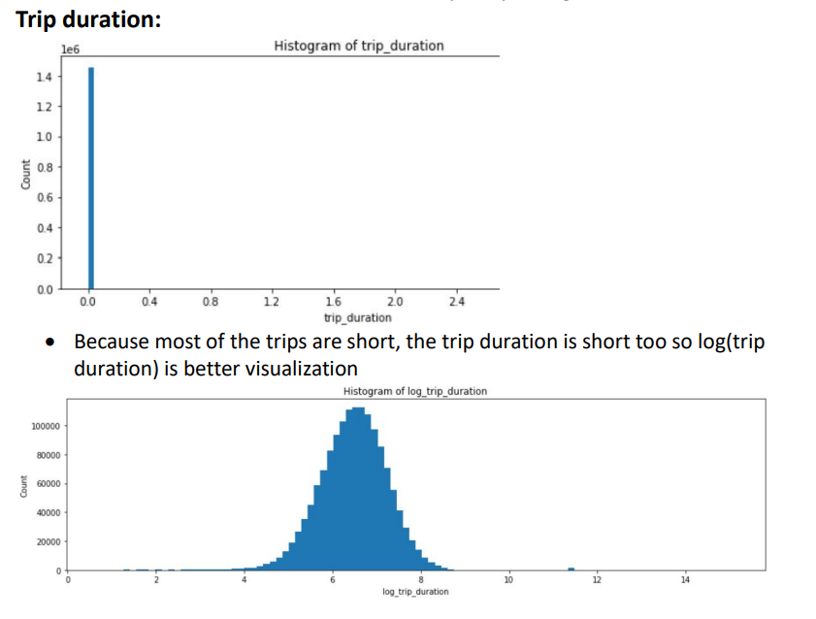

Slide 15
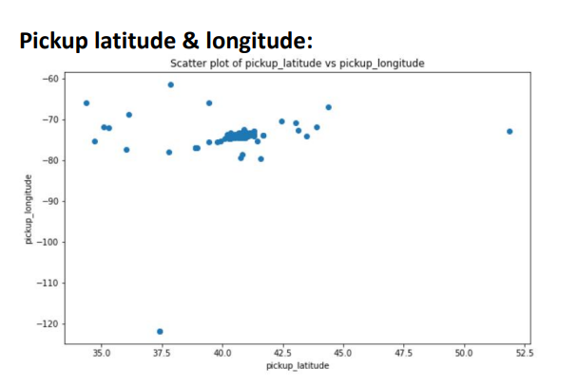

Slide 16
Extracting insights from data

Slide 17
1 - Distance features
Haversine distance
Manhattan distance
Direction

Slide 18
2- Categorical features
vendor ID
passenger count
store and forward flag
day
hour
month
week

Slide 19
Models

Slide 20
Linear regression
Decision tree regression
Random forest regression
XGBoost regression

Slide 21
Results and Evaluation

Slide 22
Models | RMSE | R-Squared Score
Linear regression | 414.42 | 0.601
Decision tree regression | 375.42 | 0.601
Random forest regression | 385.52 | 0.587
XGBoost regression | 337.25 | 0.736
XGBoost regression (No Max-Depth) | 316.57 | 0.79
StackEnsemble | 1143.8 | 0.88025

Slide 23
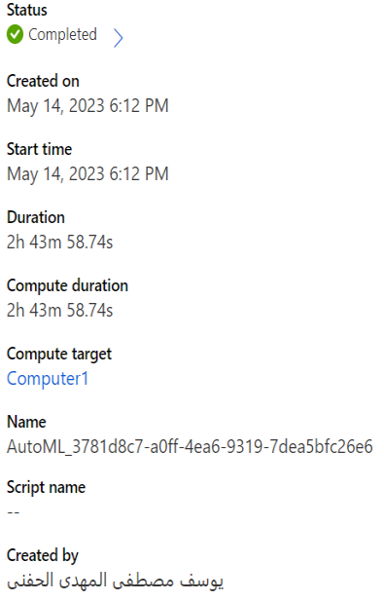
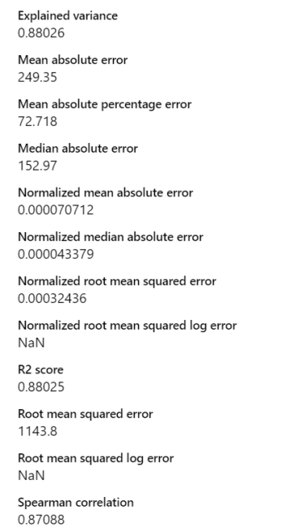

Slide 24
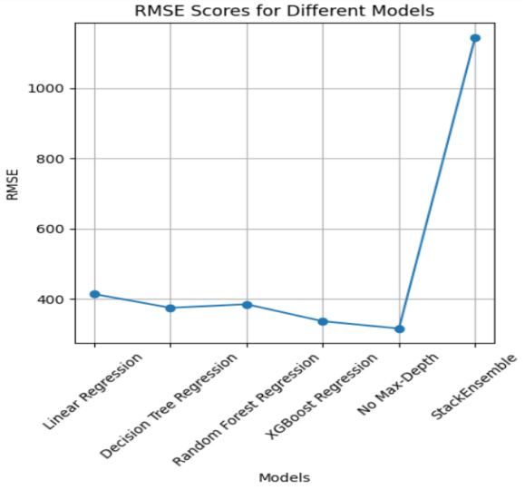

Slide 25
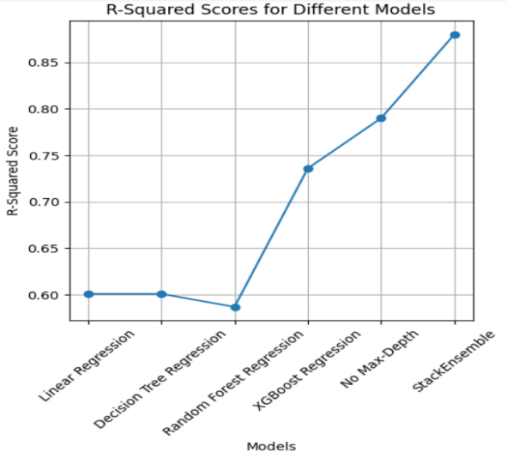

Slide 26
Future work

Slide 27
Feature engineering
Hyperparameter tuning
More data
Real-time prediction

Slide 28
Thank you

